Slide 1
SHOT TYPES
Media Production One
Close-Up
Extreme Close-Up
Medium Shot
Wide Shot
Extreme Wide Shot
High Angle
Low Angle
Over-the-Shoulder
POV
Pan
Tilt

Slide 2
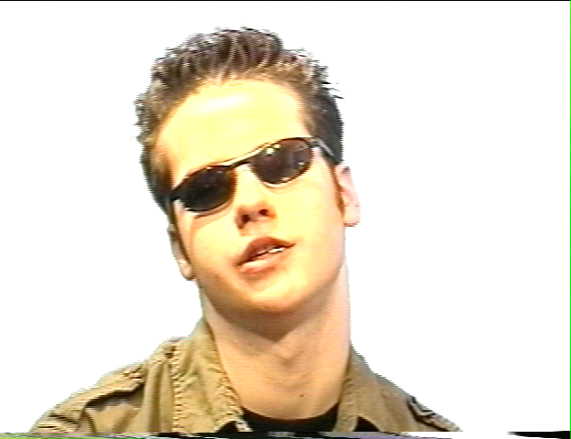
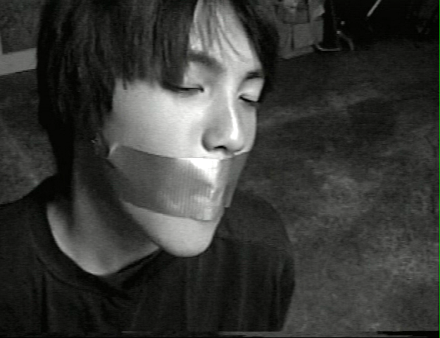
CLOSE-UP (CU)
Displays detail, facial expressions, and emotion.

Slide 3
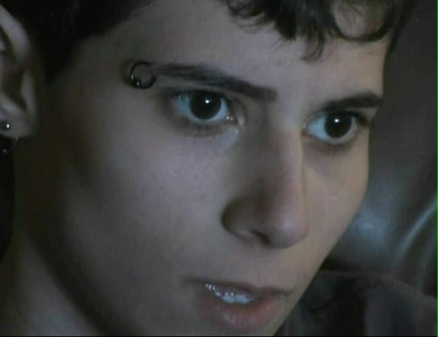
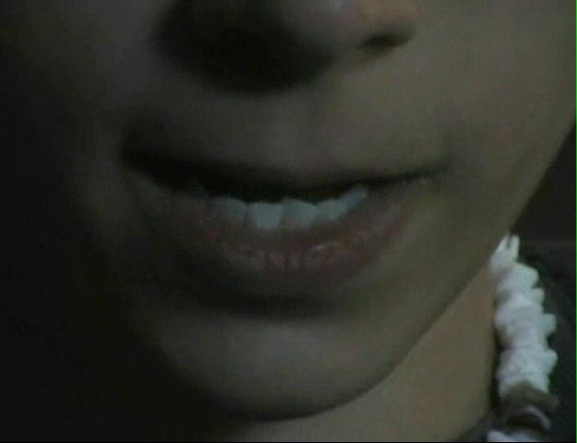
EXTREME CLOSE-UP (ECU)
Exaggerates or emphasizes a particular detail. A highly stylized shot. An extreme close-up should not linger on screen too long. It is always best to avoid cutting off the chin when composing and extreme close-up.

Slide 4
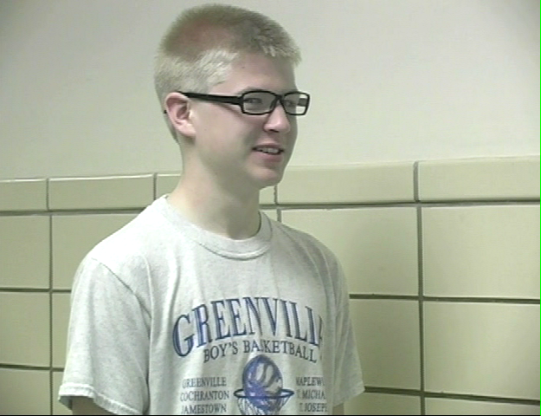
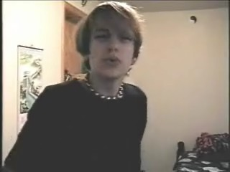
MEDIUM SHOT (MS)
When shooting a person, a medium shot typically cuts the subject off just below the chest.

Slide 5
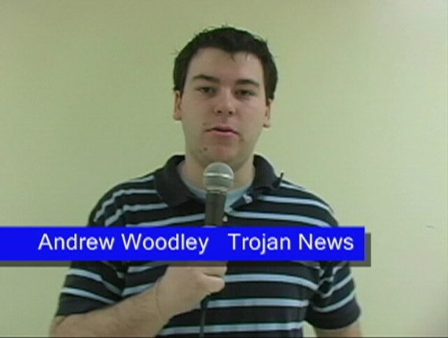
MEDIUM SHOT (MS)
Medium shots are the best way to frame news reporters and interviewees. The extra space at the bottom allows room for an identifier (the title that lists the subject’s name).

Slide 6
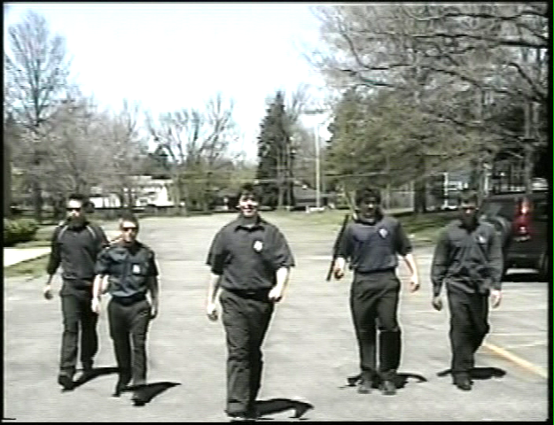
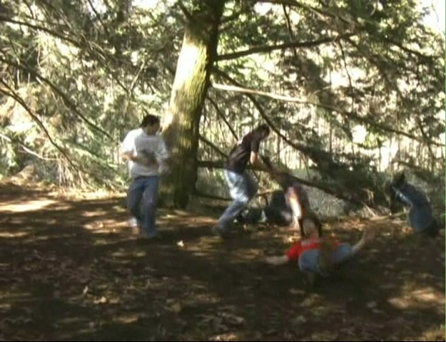
WIDE SHOT
A shot, taken from some distance, that unusually shows the subject as well as its surroundings. Wide shots orient the viewer to the space within the scene.

Slide 7
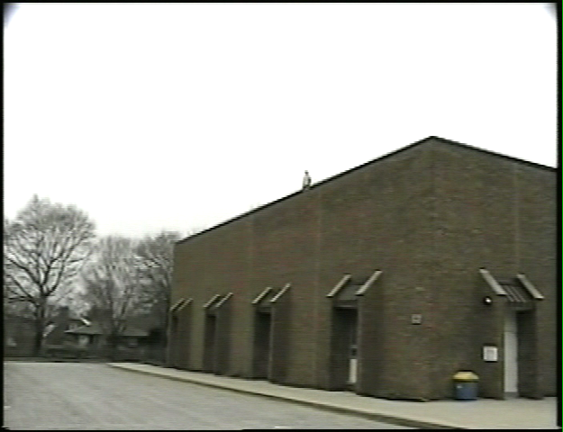
EXTREME WIDE SHOT
Similar to a typical wide shot, but much wider.

Slide 8
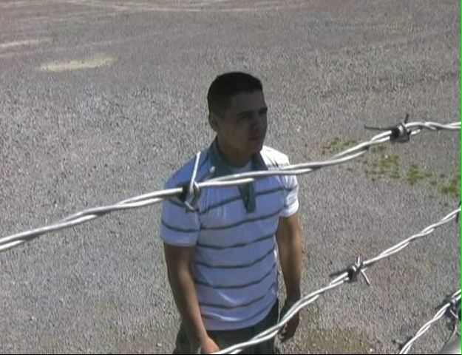
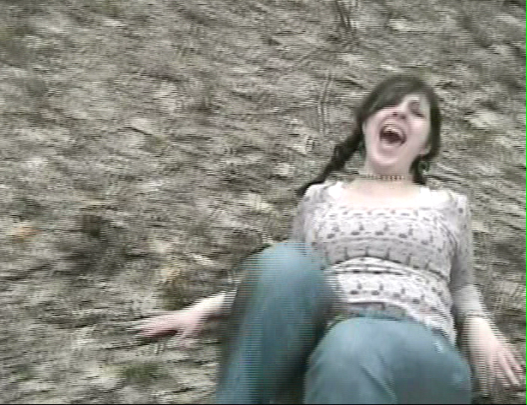
HIGH ANGLE
High angle shots make the subject appear inferior. Even a subtle high angle can subliminally indicate the vulnerability of the subject.

Slide 9
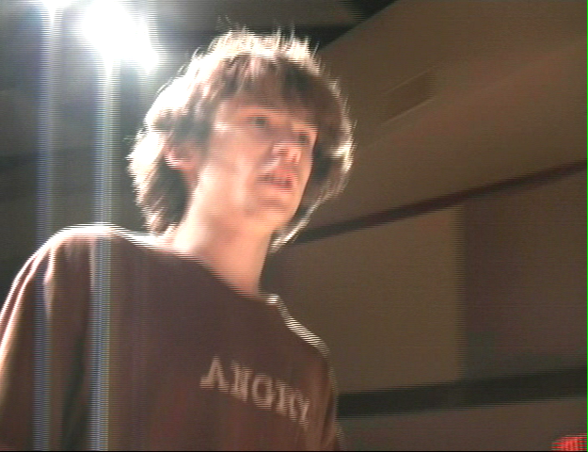
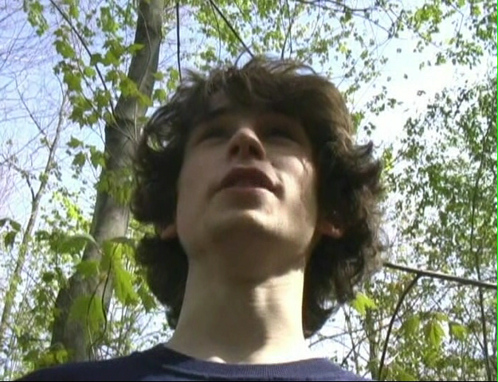
LOW ANGLE
Low angle shots make the subject appear superior. Even a subtle low angle can subliminally indicate the power of the subject.

Slide 10
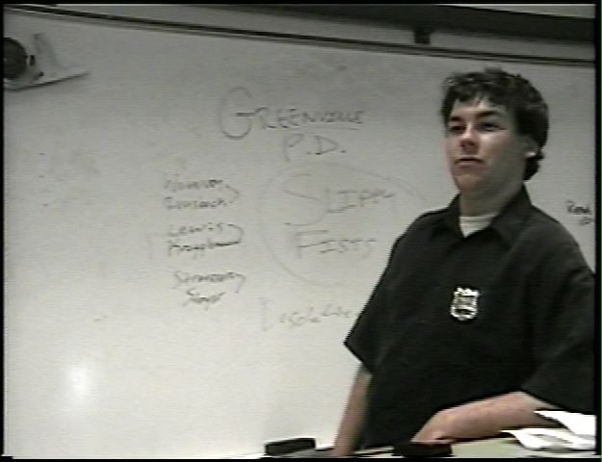
LOW ANGLE
Even a subtle low angle can subliminally indicate the power of the subject.

Slide 11
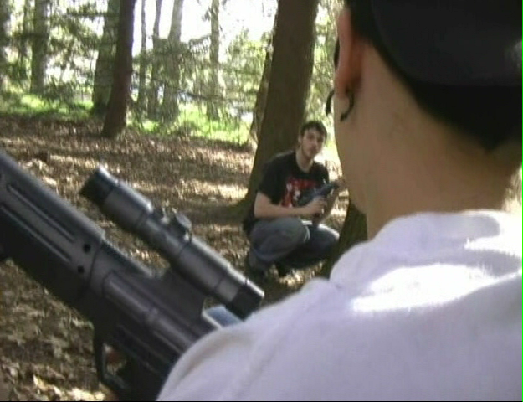
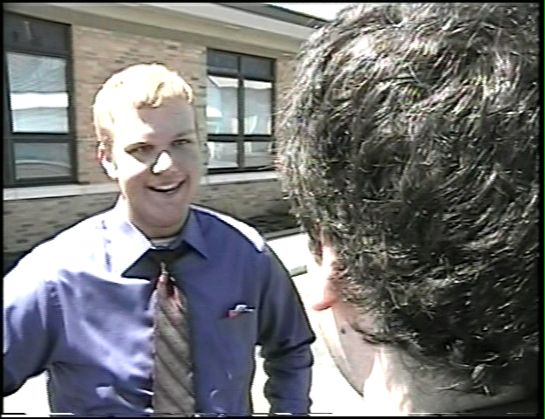
OVER-THE-SHOULDER
Over-the-shoulder shots provide the viewer with a frame of reference within the scene.

Slide 12
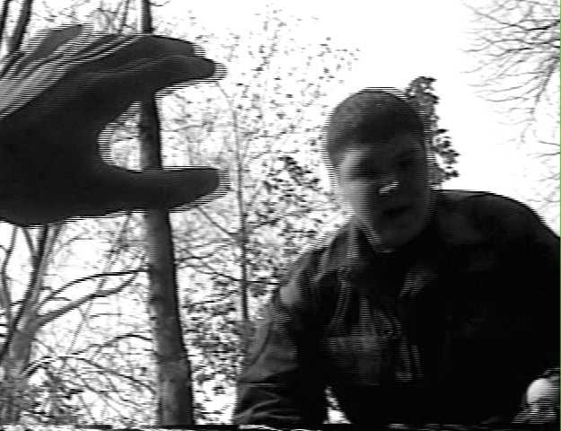
POINT-OF-VIEW
The camera “becomes” the character, offering the viewer a unique perspective of the scene. This angle often works best when a close-up of the actors face or eyes is displayed prior to the POV shot.

Slide 13
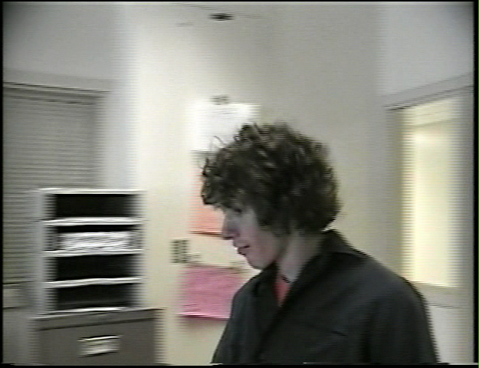
TOO MUCH HEADROOM
The camera should tilt down to remove this space.
Too much headroom makes the actor look awkward and your shot unprofessional.

Slide 14
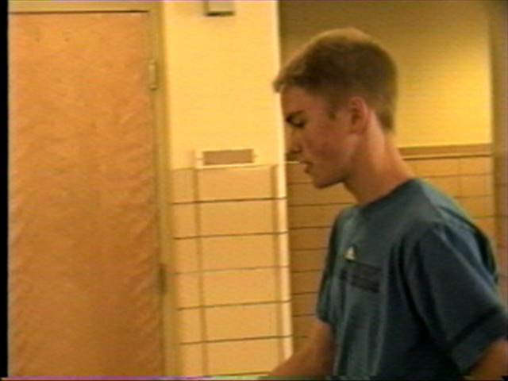
LEADROOM
It is important to allow a blank area of the screen for the actor to look or walk into. Otherwise, it just appears as if the actor is looking at the corner of the screen and not a person or object the video’s reality. Lead room is especially important when shooting sports events or other activities that involve a lot of movement.

Slide 15
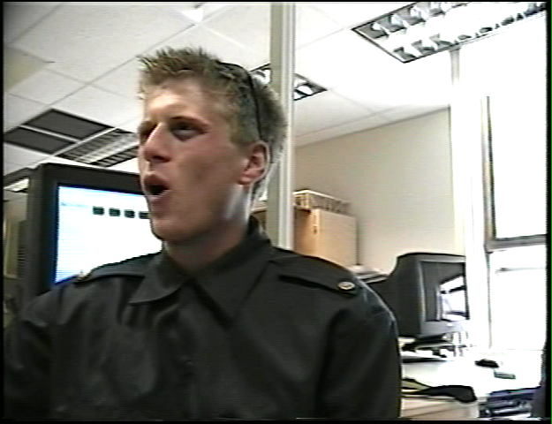
NO LEADROOM
The actor’s head should fill this space to allow for lead-room or look-room.
It is important to allow a blank area of the screen for the actor to look into. Otherwise, it just appears as if the actor is looking at the corner of the screen and not a person or object the video’s reality.

Slide 16
CAMERA MOVEMENT: PAN
PAN RIGHT
PAN LEFT
Pans are horizontal camera movements.

Slide 17
CAMERA MOVEMENT: TILT
TILT
DOWN
TILT UP
Tilts are vertical camera movements.

